Slide 1
Chapter 5
Business-to-Business Strategies: From Electronic Data Interchange to Electronic Commerce
Electronic Commerce, Seventh Annual Edition

Slide 2
Objectives
In this chapter, you will learn about:
Strategies that businesses use to improve purchasing, logistics, and other support activities
Electronic data interchange and how it works
How businesses have moved some of their electronic data interchange operations to the Internet

Slide 3
Objectives (continued)
Supply chain management and how businesses are using Internet technologies to improve it
Electronic marketplaces and portals that make purchase-sale negotiations easier and more efficient

Slide 4
Purchasing, Logistics, and Support Activities
Purchasing activities
  Include identifying vendors, evaluating vendors, selecting specific products, and placing orders
Supply chain
  Part of an industry value chain that precedes a particular strategic business unit

Slide 5
Purchasing, Logistics, and Support Activities (continued)
Procurement
  Includes all purchasing activities, plus the monitoring of all elements of purchase transactions
Supply management
  Term used to describe procurement activities

Slide 6
Purchasing, Logistics, and Support Activities (continued)
Sourcing
  Procurement activity devoted to identifying suppliers and determining their qualifications
E-procurement or e-sourcing
  Use of Internet technologies in procurement and sourcing activities

Slide 7
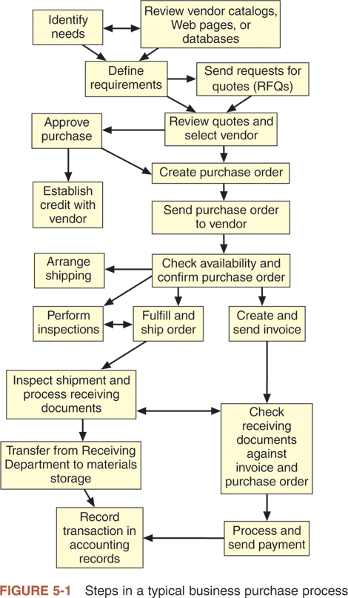

Slide 8
Direct vs. Indirect Materials Purchasing
Direct materials
  Materials that become part of the finished product in a manufacturing process
Replenishment purchasing
  The company negotiates long-term contracts for most of the materials that it will need
Indirect materials
  Other materials that the company purchases, including factory supplies

Slide 9
Logistics Activities
Logistics activities include managing:
  Inbound movements of materials and supplies
  Outbound movements of finished goods and services
Objective of logistics
  To provide the right goods in the right quantities in the right place at the right time
Logistics management
  Important support activity for both sales and purchasing activities

Slide 10
Support Activities
Support activities
  Include categories of finance and administration, human resources, and technology development
Knowledge management
  Intentional collection, classification, and dissemination of information about a company, its products, and its processes

Slide 11
E-Government
Use of electronic commerce by governments and government agencies to:
  Perform functions for their stakeholders
  Employ people, buy supplies from vendors, and distribute benefit payments
  Collect taxes and fees from constituents

Slide 12
Electronic Data Interchange
EDI is the computer-to-computer transfer of business information between two businesses
EDI-compatible firms are firms that exchange data in specific standard formats
  Business information exchanged is often transaction data
Most B2B electronic commerce is an adaptation of EDI or based on EDI principles

Slide 13
Early Business Information Interchange Efforts
1950s
  Companies began to use computers to store and process internal transaction records
1968
  A number of freight and shipping companies formed the Transportation Data Coordinating Committee (TDCC)
TDCC created a standardized information set

Slide 14
Emergence of Broader EDI Standards
American National Standards Institute (ANSI)
  Has been the coordinating body for standards in the United States since 1918
  Does not set standards itself
  Has created a set of procedures for the development of national standards
  Accredits committees that follow set procedures

Slide 15
Emergence of Broader EDI Standards (continued)
Accredited Standards Committee X12 (ASC X12)
  Chartered by ANSI to develop uniform EDI standards
  Includes information systems professionals from over 800 businesses and other organizations
Transaction sets
  Names of formats for specific business data interchanges

Slide 16
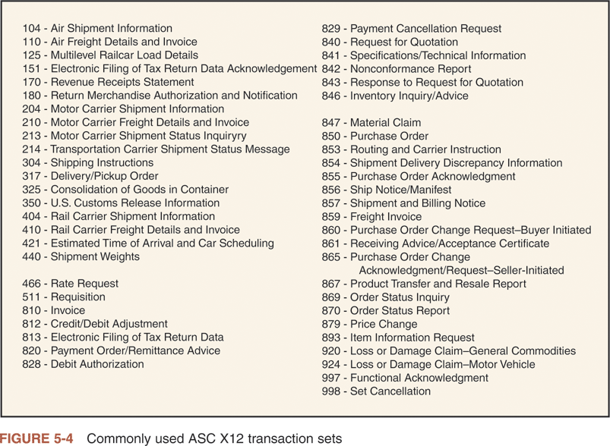

Slide 17
Emergence of Broader EDI Standards (continued)
1987
  United Nations published its first standards under the title EDI for Administration, Commerce, and Transport (EDIFACT, or UN/EDIFACT)
Late 2000
  ASC X12 organization and UN/EDIFACT group agreed to develop one common set of international standards

Slide 18
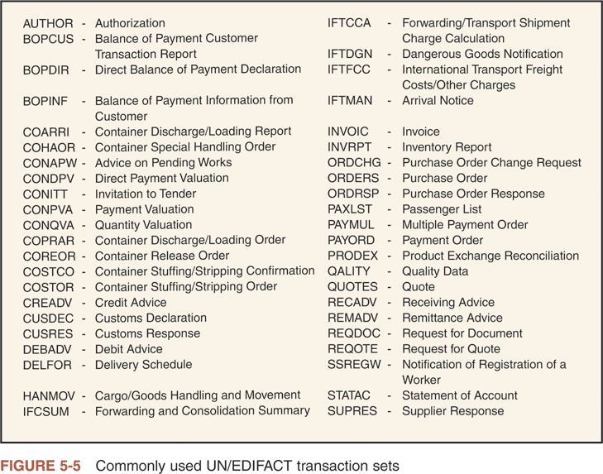

Slide 19
How EDI Works
EDI
  Implementation can be complicated
Example:
  Consider a company that needs a replacement for one of its metal-cutting machines
  Paper-based purchasing process
    Buyer and vendor are not using any integrated software
    Information transfer between buyer and vendor is paper based

Slide 20
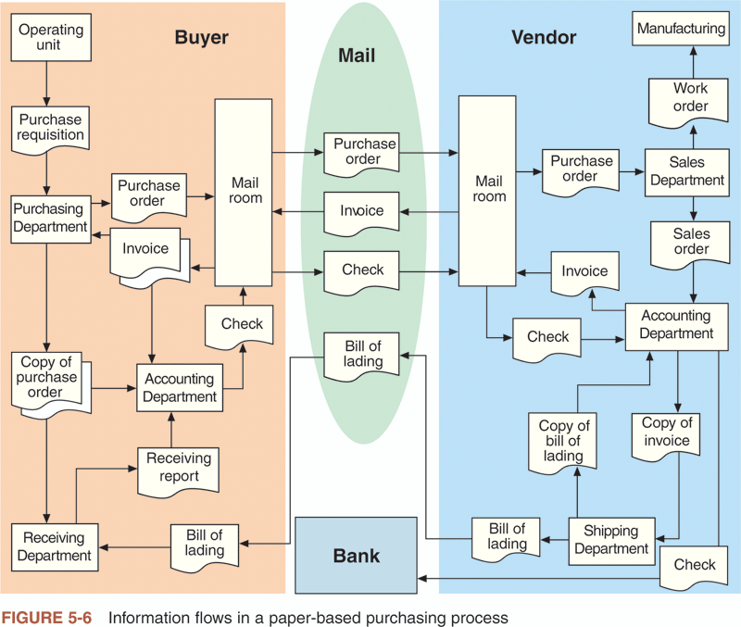

Slide 21
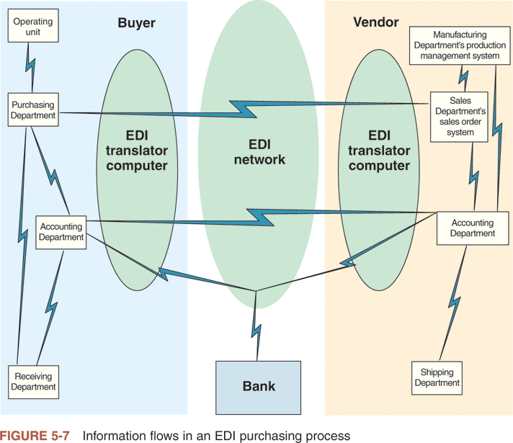

Slide 22
Value-Added Networks
Direct connection EDI
  Requires each business in the network to operate its own on-site EDI translator computer
  EDI translator computers are connected directly to each other using modems and dial-up telephone lines or dedicated leased lines

Slide 23
Value-Added Networks (continued)
Indirect connection EDI
  To send an EDI transaction set to a trading partner:
    VAN customer connects to the VAN then forwards an EDI-formatted message to the VAN
    VAN logs the message and delivers it to the trading partner’s mailbox
    Trading partner then dials in to the VAN and retrieves its EDI-formatted messages

Slide 24
Advantages of Using a VAN
Users need to support only the VAN’s one communications protocol
The VAN:
  Records message activity in an audit log
  Can provide translation between different transaction sets used by trading partners
  Can perform automatic compliance checking

Slide 25
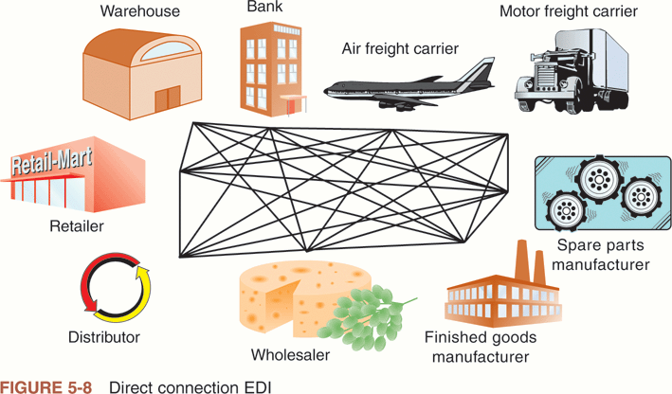

Slide 26
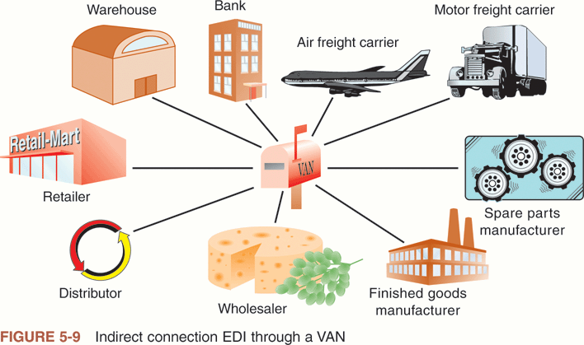

Slide 27
Disadvantages of Using a VAN
Cost
  Most VANs require an enrollment fee, a monthly maintenance fee, and a transaction fee
Using VANs can become cumbersome and expensive for companies that want to do business with a number of trading partners, each using different VANs

Slide 28
EDI on the Internet
Initial roadblocks to conducting EDI over the Internet included:
  Concerns about security
  The Internet’s inability to provide audit logs and third-party verification of message transmission and delivery
Nonrepudiation
  Ability to establish that a particular transaction actually occurred

Slide 29
Open Architecture of the Internet
Internet EDI or Web EDI
  EDI on the Internet
Open architecture of the Internet allows trading partners unlimited opportunities for customizing information interchanges
New tools such as XML help trading partners be even more flexible in exchanging detailed information

Slide 30
Financial EDI
Financial EDI are the EDI transaction sets that provide instructions to a trading partner’s bank
Automated clearing house (ACH) system
  Service that banks use to manage accounts with each other
EDI-capable banks
  Equipped to exchange payment and remittance data through VANs

Slide 31
Financial EDI (continued)
Value-added banks (VABs)
  Banks that offer VAN services for nonfinancial transactions
Financial VANs (FVANs)
  Nonbank VANs that can translate financial transaction sets into ACH formats

Slide 32
Supply Chain Management Using Internet Technologies
Supply chain management
  Used to add value in benefits to the ultimate consumer at the end of the supply chain
Tier one suppliers
  Develop long-term relationships with a large number of suppliers
Tier two suppliers
  Manage relationships with the next level of suppliers

Slide 33
Supply Chain Management Using Internet Technologies (continued)
Tier three suppliers
  Provide tier two suppliers with components and raw materials
Supply alliances
  Long-term relationships created among participants in the supply chain

Slide 34
Supply Chain Management Using Internet Technologies (continued)
Key element of successful supply chain management
  Clear communications and quick responses
Major disadvantage of using Internet technologies in supply chain management
  The cost of the technologies

Slide 35
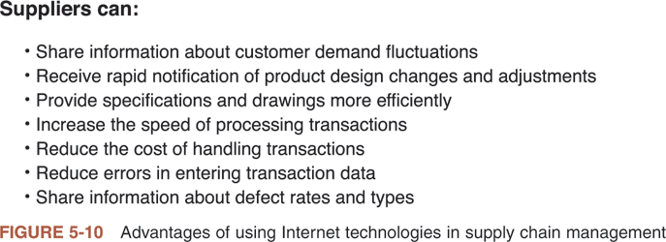

Slide 36
Building and Maintaining Trust in the Supply Chain
Major issue for most companies is developing trust
Key elements for building trust include continual communication and information sharing

Slide 37
Electronic Marketplaces and Portals
Vertical portals (vortals)
  Offer a doorway (or portal) to the Internet for industry members
  Vertically integrated

Slide 38
Independent Industry Marketplaces
Industry marketplaces
  Focused on a single industry
Independent exchanges
  Not controlled by a company that was an established buyer or seller in the industry
Public marketplaces
  Open to new buyers and sellers just entering the industry

Slide 39
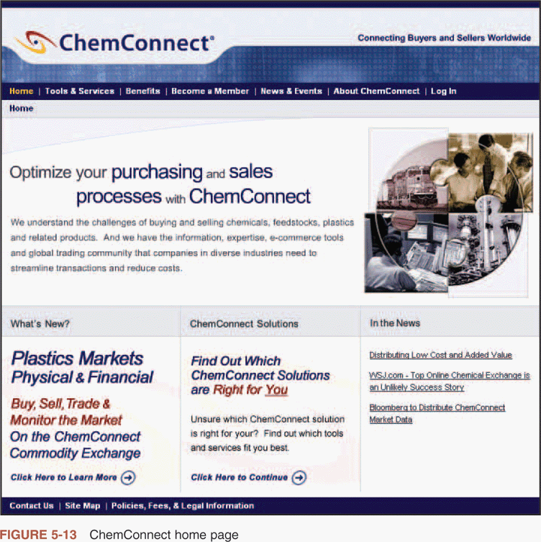

Slide 40
Private Stores and Customer Portals
Private store
  Has a password-protected entrance
  Offers negotiated price reductions on a limited selection of products
Customer portal sites
  Offer private stores along with services

Slide 41
Private Company Marketplaces
E-procurement software
  Allows a company to manage its purchasing function through a Web interface
Private company marketplace
  A marketplace that provides auctions, request for quote postings, and other features

Slide 42
Industry Consortia-Sponsored Marketplaces
Formed by several large buyers in a particular industry
Covisint
  Created in 2000 by a consortium of DaimlerChrysler, Ford, and General Motors
In the hotel industry Marriott, Hyatt, and three other major hotel chains formed a consortium to create Avendra

Slide 43
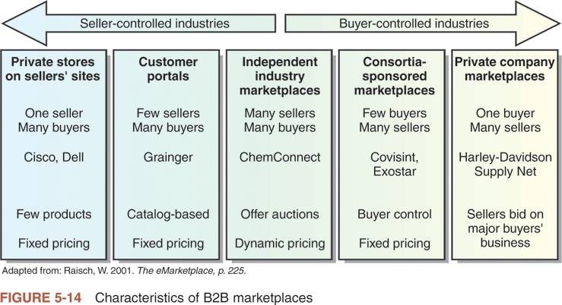

Slide 44
Summary
Companies are using Internet and Web technologies to improve their purchasing and logistics primary activities
EDI
  First developed by freight companies to reduce the paperwork burden
Internet
  Now providing the inexpensive communications channel that EDI lacked

Slide 45
Summary (continued)
Supply chain management
  Incorporates several elements that can be implemented and enhanced through the use of the Internet and the Web
Models for B2B electronic commerce
  Private stores, customer portals
  Private marketplaces
  Industry consortia-sponsored marketplaces

